Slide 1
Data-Driven Insights for Digital Marketing Campaigns
BY:
SRIMATHI K

Slide 2
Problem Statement
Digital campaigns generate large amounts of data
Businesses struggle to convert data into insights
Difficult to track performance and ROI across channels
Creating dashboards and analytics for better decisions.
Dataset Provided:
The dataset provided a comprehensive view of marketing performance across channels, users, and conversions, enabling end to end analysis of campaign effectiveness

Slide 3
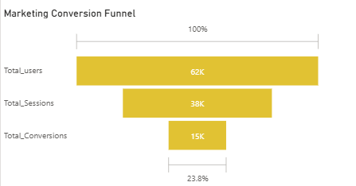
Marketing Conversion Funnel
There is a large drop from 62K users to 38K sessions, meaning many users are not engaging after landing.
Further drop to 15K conversions shows that only a portion of engaged users complete actions.
Overall conversion rate of 23.8% indicates scope for improvement in the user journey.

Slide 4
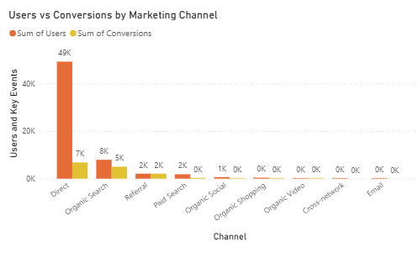
Users vs Conversions by Channel
Direct channel brings the highest traffic but does not convert efficiently → optimize homepage and user journey.
Organic Search shows strong balance between traffic and conversions → increase focus on SEO efforts.
Other channels contribute very little → reassess or reduce investment in low-performing channels.

Slide 5
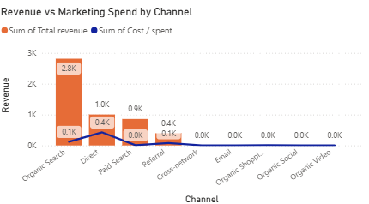
Revenue vs Marketing Spend by Channel
Organic Search generates high revenue with low cost → increase budget allocation here.
Direct channel has moderate returns with higher cost → improve conversion efficiency.
Some channels incur cost but generate little or no revenue → optimize or eliminate underperforming campaigns.

Slide 6
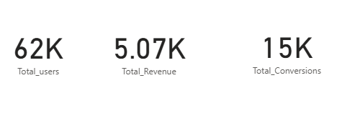
KPI Summary
High user volume (62K) but lower conversions (15K) indicates inefficiency → focus on improving conversion rate.
Revenue is moderate compared to traffic size → prioritize high-intent users.
There is a gap between acquisition and monetization → optimize key conversion touchpoints.

Slide 7
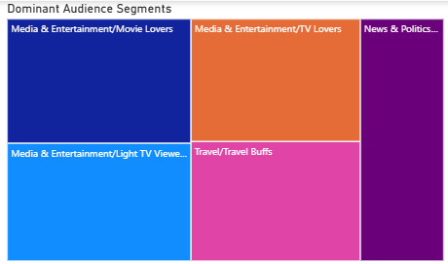
Dominant Audience Segments
Media & Entertainment and Technology segments dominate user base → focus marketing campaigns on these high-interest segments.
Audience is concentrated in a few categories rather than evenly distributed → personalize content for top segments to increase engagement.
Some segments have lower representation → explore targeted campaigns to expand reach in untapped segments.

Slide 8
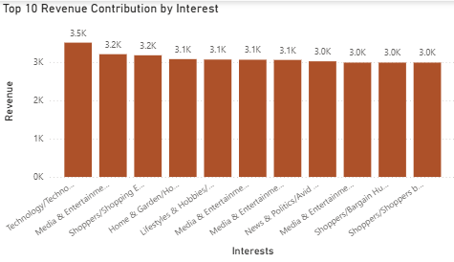
Top 10 Revenue Contribution by Interest
Revenue contribution is relatively similar across top interests → no single segment overwhelmingly dominates revenue.
Technology and Media related interests slightly lead in revenue → prioritize these segments for better ROI.
Smaller differences suggest opportunity to optimize multiple segments → apply targeted strategies across top performing interests.

Slide 9
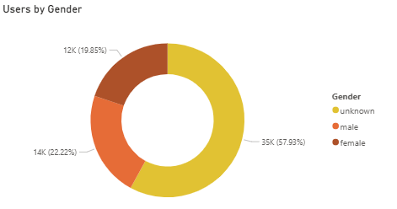
Users by Gender
A large portion of users fall under “unknown” category → improve data tracking and user profiling.
Male and female users are relatively balanced → maintain inclusive marketing strategies.
Female users contribute significant share → consider targeted campaigns for higher engagement and conversions.

Slide 10
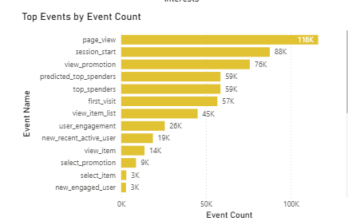
Top Events by Event Count
Page views and session starts dominate user activity → users are browsing more than converting.
High drop-off from browsing events to conversion-related events → optimize user journey to improve conversions.
Lower counts in key action events (like select_item) → improve CTA placement and product visibility.

Slide 11
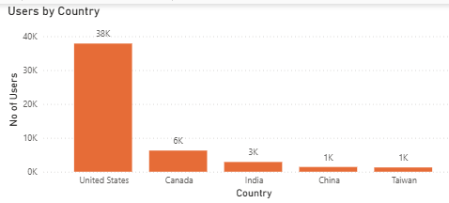
Users by Country
United States contributes the majority of users compared to other countries → prioritize marketing efforts in this region for maximum impact.
Significant drop in users after top countries indicates uneven geographic distribution → expand campaigns in emerging markets like India and Canada.
Lower contribution from other countries shows untapped potential → localize marketing strategies to improve reach.

Slide 12
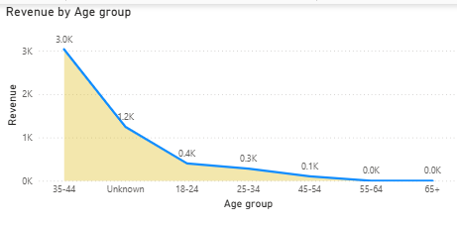
Revenue by Age group
Age group 35–44 generates the highest revenue → focus targeting on this high-value segment.
Younger groups (18–34) show lower revenue despite engagement → optimize conversion strategies for these users.
Older age groups (55+) contribute minimal revenue → reassess targeting or reduce focus on low-performing segments.

Slide 13
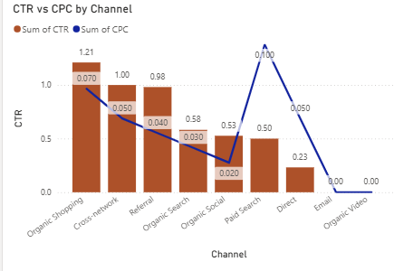
CTR vs CPC by Channel
Some channels show high CTR but also high CPC → optimize campaigns to balance cost and performance.
Organic channels maintain reasonable CTR with low CPC → prioritize organic strategies for cost efficiency.
Certain channels show low CTR and low impact → improve ad creatives or reduce investment.

Slide 14
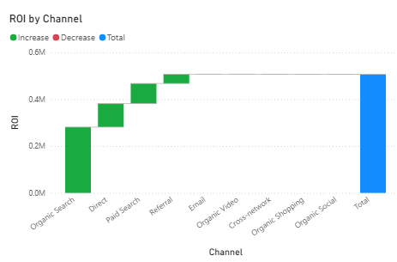
ROI By Channel
Organic Search contributes the highest ROI → increase investment in this channel.
Direct and Paid Search also add positive ROI → optimize these channels for better returns.
Some channels show negligible or no contribution → eliminate or improve underperforming channels.

Slide 15
Key Patterns
High traffic is driven by Direct and Organic Search, but conversion efficiency is low.
Organic Search delivers the highest ROI, making it the most effective channel.
Users are highly active in browsing events, but drop off before completing conversions.
Revenue is concentrated in specific segments (Media, Technology, age 35–44).
Geographic performance is uneven, with USA dominating traffic and other markets underutilized.

Slide 16
Strategic Recommendations & Action Plan
1. Channel Optimization
Organic Search generates the highest revenue (~2.8K) with low cost, while Direct drives ~49K users but lower conversion efficiency → increase SEO investment and optimize homepage experience for Direct traffic.
2. Conversion Improvement
There is a drop from 62K users → 38K engaged sessions → 15K conversions (23.8%), indicating major funnel inefficiency → improve landing pages, simplify navigation, and add stronger CTAs.
3. Audience Targeting
Media & Technology segments contribute the highest revenue (~3K+ each), and age group 35–44 generates ~3K revenue → focus campaigns on these high-value segments.
4. Remarketing Strategy
User activity is high in browsing events (116K page views, 88K session starts) but conversions are much lower (15K) → implement remarketing to re-engage non-converting users.
5. Budget Optimization
Channels like Email, Cross-network, and Organic Video contribute near 0 revenue and minimal users → reallocate budget toward high-performing channels like Organic Search and Direct.

